Slide 1

Department of Computer Science and Engineering
Lakshmi Narain College OF Technology

Slide 2
IOT Based Water Logging System
Problem-
Mostly in metro as well as in Bigger Cities there is water logging problem there are mainly two cases when water logging is a big panic
1.Heavy Rain fall
2.Failure of Drainage System
3.Poor Condition of Our Drainage System

Slide 3
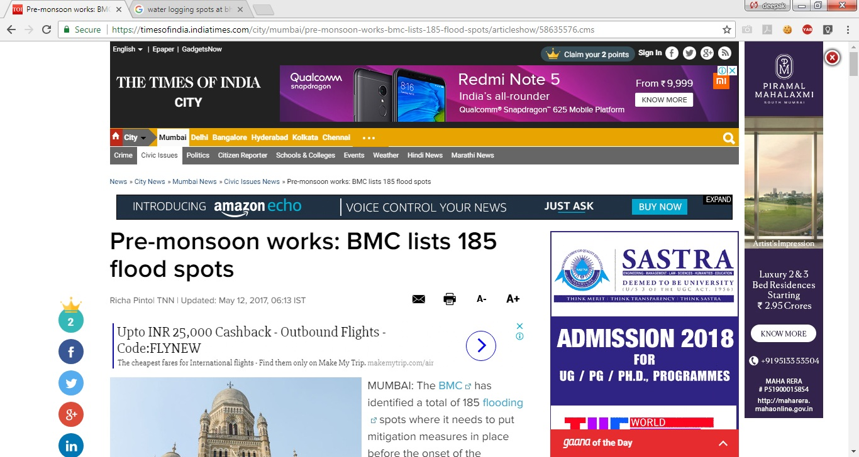

Slide 4
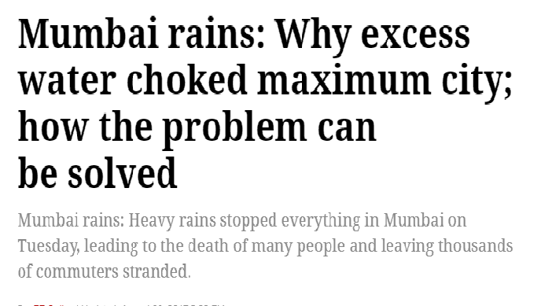

Slide 5
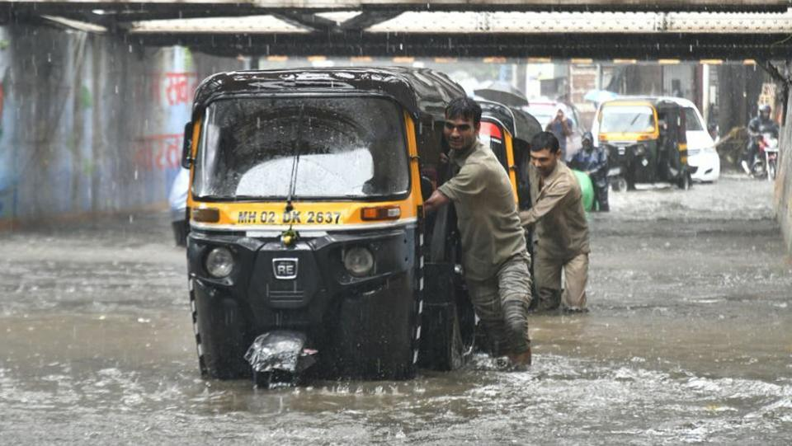
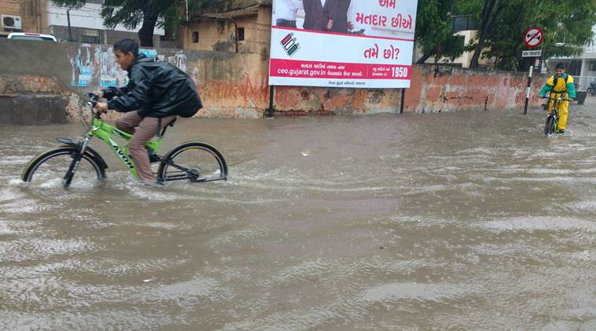
.Bhopal- Although Bhopal is not a metro city but it is also going to be a Smart city but here also we have some of main places that require our system
1.Chetak Bridge
2.Jyoti Cinema Chouraha

Slide 6
WORKING OF IOT HACK

Slide 7
Identification of the Water logging places
Implementation of IOT System
Data Sending On cloud
After threshold level automatically starting of System which will resolve the Water Logging System
Getting Data on our app
System can also be start befor threshold value through our app by the admin
Any body using our app can see live details of water logging
Live update of Data on our website

Slide 8
Implementation of System which automatically Resolve the Water logging problem
By using mini water pumps
Connecting it through our app by using cloud
Mini pump can be easily controlled through our app by admins

Slide 9
Features Of Our System-
1.IOT Based
2.Cheap
3.User Friendly
4.Less Power Consumer
5. Provide Instant Service
6.Durable as compared to traditional Systems

Slide 10
Applications of our system-
To cope up Water Logging Problem.
As a Warning System at time of Flood.
In agriculture as Irrigation control System.

Slide 11
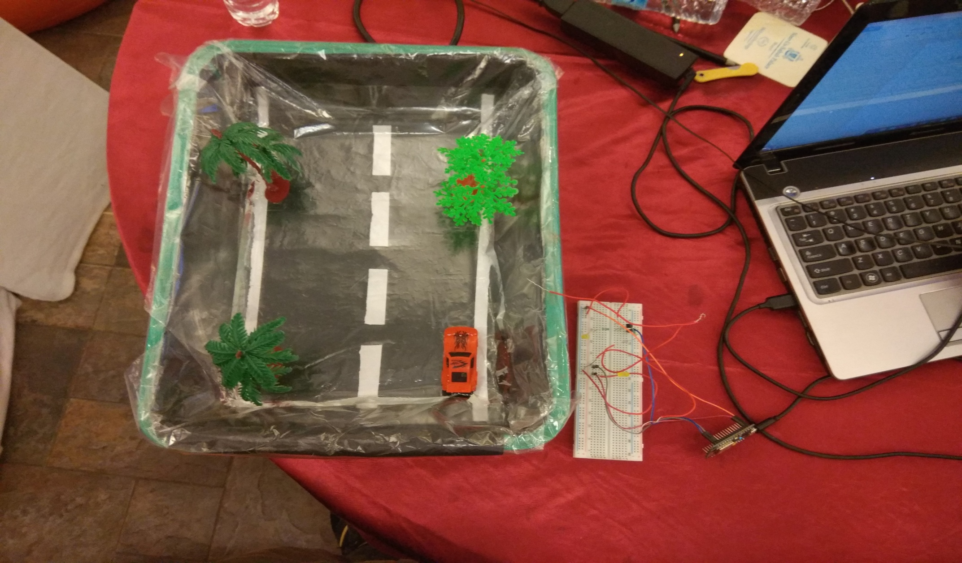
Small Prototype of Hack

Slide 12

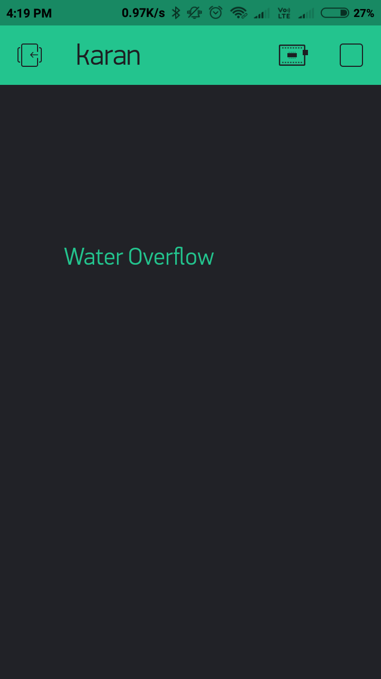

Slide 13
Presened by
1.Karan Panchal
2.Deepak Pandey

